Slide 1
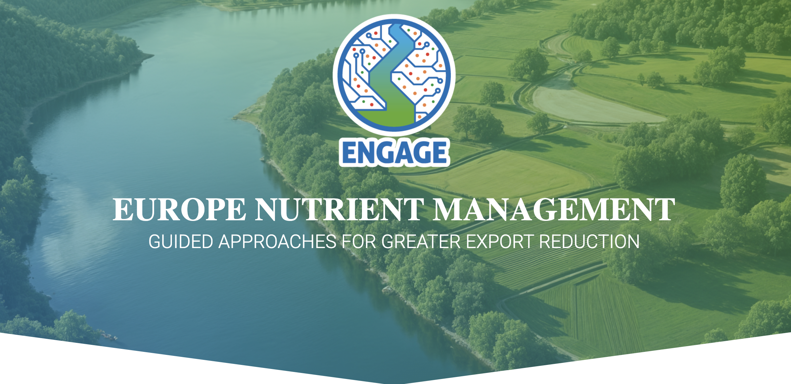


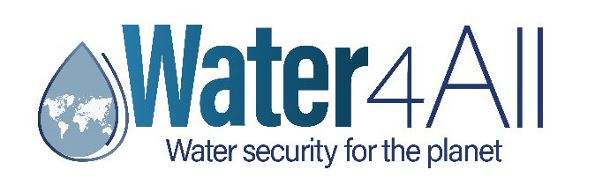


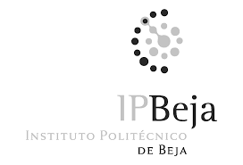


Slide 2
GOAL & OBJECTIVES
WATER4ALL 2023 JTC ON “AQUATIC ECOSYSTEM SERVICES”
Problem: Despite efforts such as the Water Framework and Nitrates Directives, eutrophication remains a major challenge, degrading regulating and cultural ecosystem services. Climate and land use change further exacerbates nutrient pollution, impacting regions differently.
ENGAGE’s goal: Operationalize a novel approach for multi-scale nutrient management in European river basins, co-designing strategies with stakeholders to maximize diversity of ecosystem services.
ENGAGE’s objectives:
  Objective 1: Stakeholder Engagement for Collaborative Nutrient Control
  Objective 2: Co-Design & Application of Decision Support Tool (DST)
  Objective 3: Knowledge Transfer & EU-Level Scaling

Slide 3
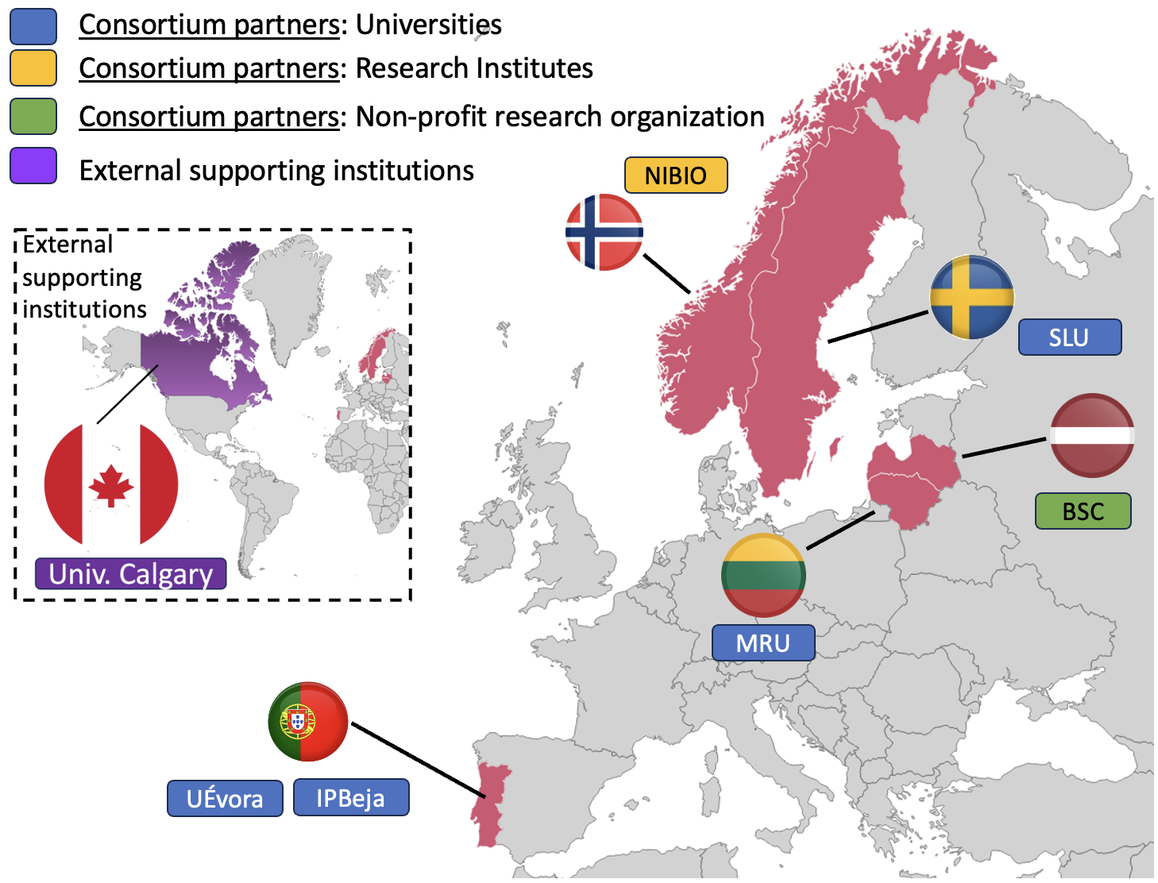
CONSORTIUM: 6 partners from 5 countries
WATER4ALL 2023 JTC ON “AQUATIC ECOSYSTEM SERVICES”
Portugal: Univeristy of Évora and Instituto Politécnico de Beja
Latvia: Nodibinajums Baltic Studies Centre
Lithuania: Mykolas Romeris University
Norway: Norwegian Institute of Bioeconomy Research
Sweden: Swedish University of Agricultural Sciences

Slide 4
METHODOLOGY
WATER4ALL 2023 JTC ON “AQUATIC ECOSYSTEM SERVICES”
PHASE I – Multi-Basin Testing: Nutrient control strategies examined for 3 diverse European river basins:
  Guadiana (Portugal/Spain): Transboundary, large basin
  Gauja-Koiva (Latvia/Estonia): Transboundary, medium-size basin
  Hobølelva (Norway): Small, cross-scale reference
  .
PHASE II – Scaling & Replication: Guidelines for Replication & EU Scaling
  Develop EU-wide nutrient control guidelines with input from the SB-Network, representing:
  Regional SBs from participating basins (Portugal, Spain, Latvia, Estonia, Norway)
  Stakeholders from additional EU member states

Slide 5
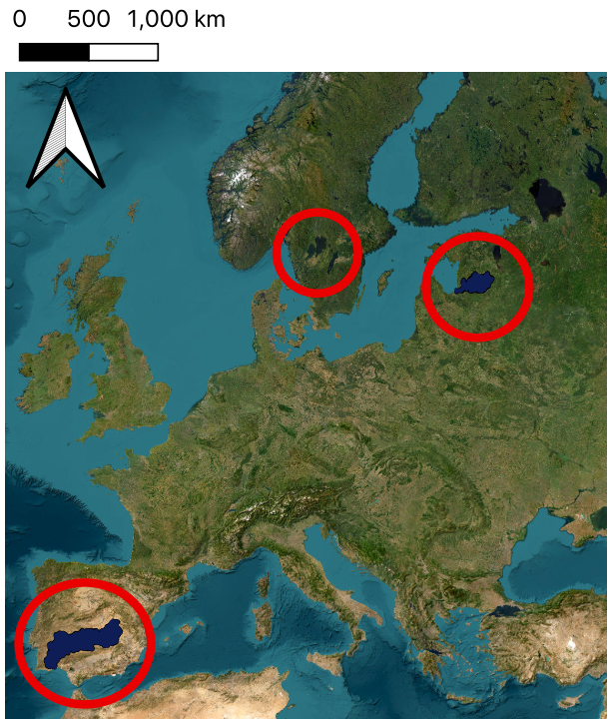
METHODOLOGY
WATER4ALL 2023 JTC ON “AQUATIC ECOSYSTEM SERVICES”
RB1 - Guadiana River Basin (Portugal & Spain)
67,100 km²; Spain (83%), Portugal (17%)
Alqueva Dam (4150 hm³) supports irrigation (100,000 ha) & hydropower
Eutrophic reservoir due to nutrient loads
RB2 - Gauja-Koiva River Basin (Latvia & Estonia)
14,380 km²; Latvia (90.75%), Estonia (9.25%)
Low anthropogenic pressure, 50% forest, protected areas
Challenges: fertilizer legacy, water abstraction, nitrate-vulnerable zones
RB3 - Hobølelva River Basin (Norway)
335 km²; drains into Lake Vansjø & Oslo Fjord
20% agriculture, key for nutrient pollution mitigation
Focus area in ENGAGE: Kråkstad subcatchment (40% agriculture)
Connected to Nordbalt-Ecosafe & OPTAIN projects
RB3
RB2
RB1

Slide 6
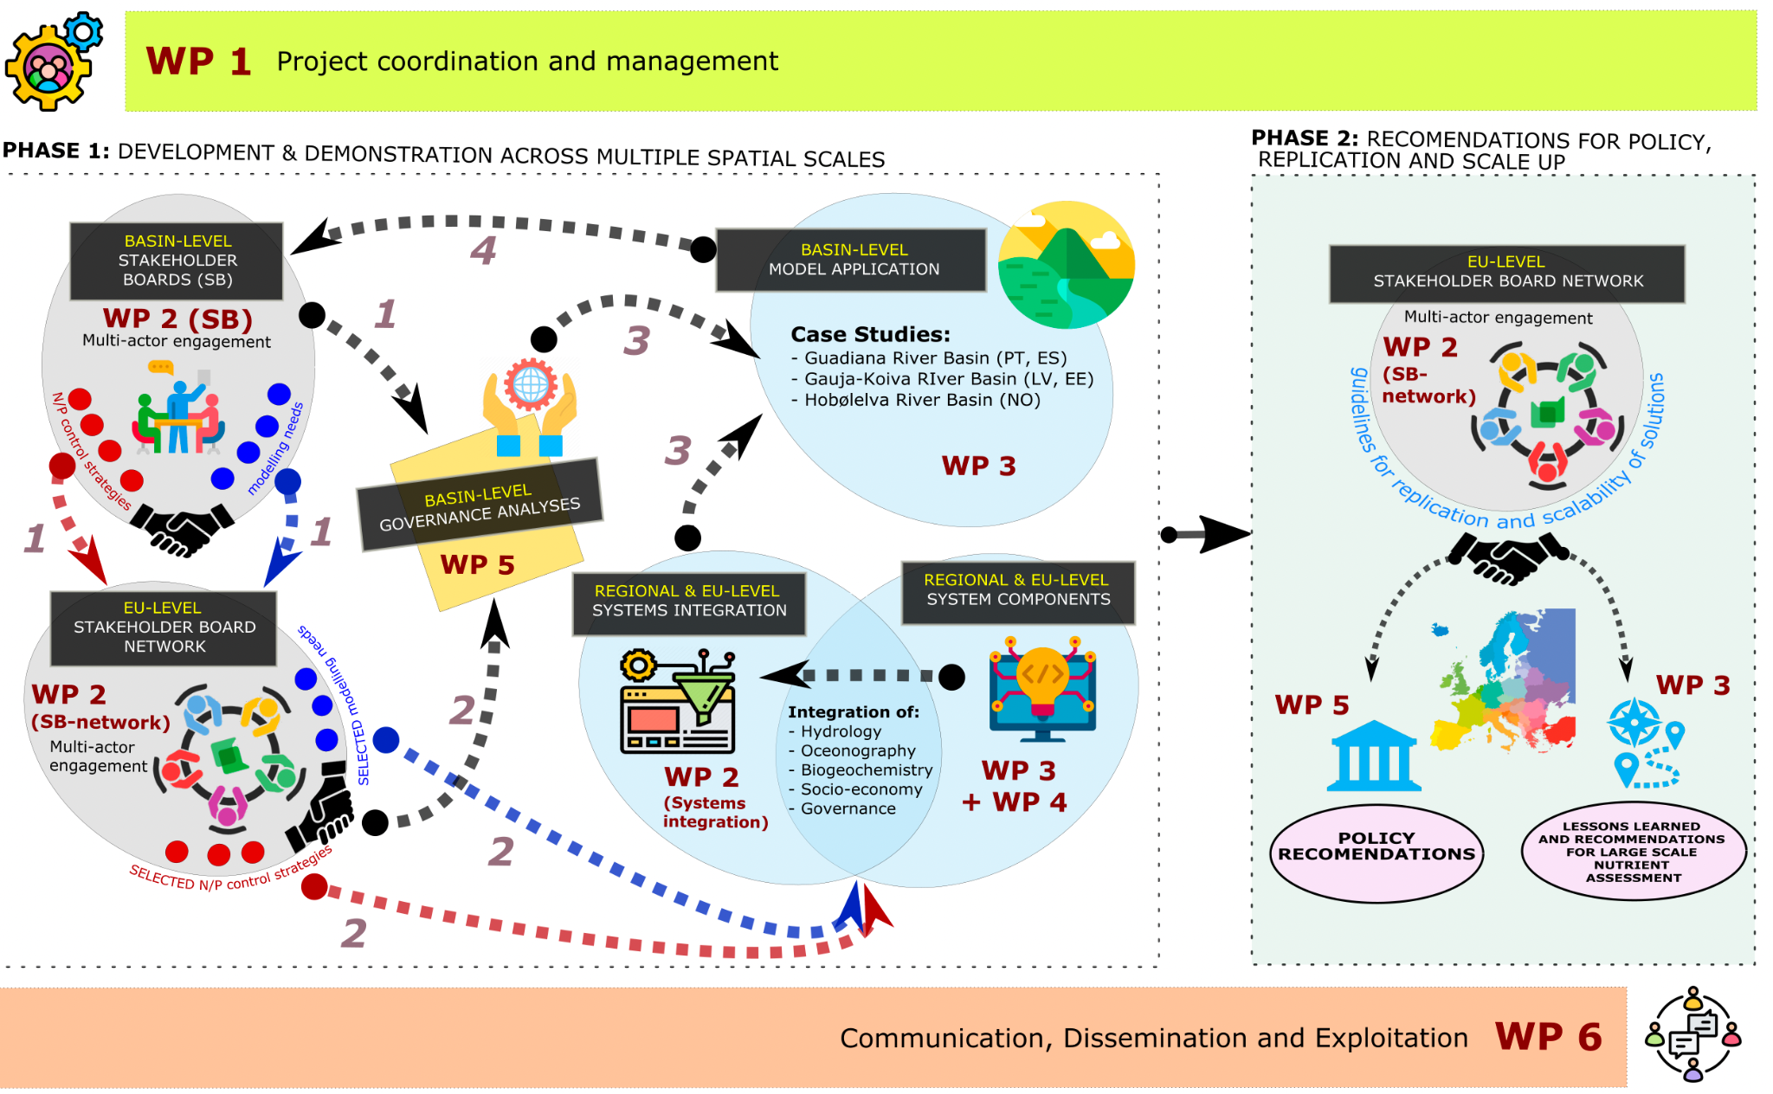
WATER4ALL 2023 JTC ON “AQUATIC ECOSYSTEM SERVICES”

Slide 7
Dissemination & Communication
Stakeholder Engagement: Targeting government, farmers, communities, NGOs, policymakers, academia, and the public.
Open & FAIR Access: Publishing in open journals, sharing data on ZENODO/GitHub, and presenting at conferences.
Policy & Knowledge Transfer: ENGAGE website as an info hub; policy briefs for practical impact.
Inclusive Communication: Ensuring public engagement, open science, and gender equality.

Slide 8
EXPECTED IMPACT OF ENGAGE
WATER4ALL 2023 JTC ON “AQUATIC ECOSYSTEM SERVICES”
Co-design and develop with stakeholders a DST for practical application in the development of nutrient management strategies that balance economic needs with environmental and socio-cultural requirements (integrating biophysical, biogeochemical, socio-economic, and governance elements)
Apply the DST to three case studies
Strengthening transboundary cooperation in nutrient pollution control
Guidelines for replication to other regions

Slide 9

Questions
WATER4ALL 2023 JTC ON “AQUATIC ECOSYSTEM SERVICES”

